Slide 1
Space Health and Medicine: Psychological, physiological and behavioral stress
Genesis(Team-7)

Slide 2
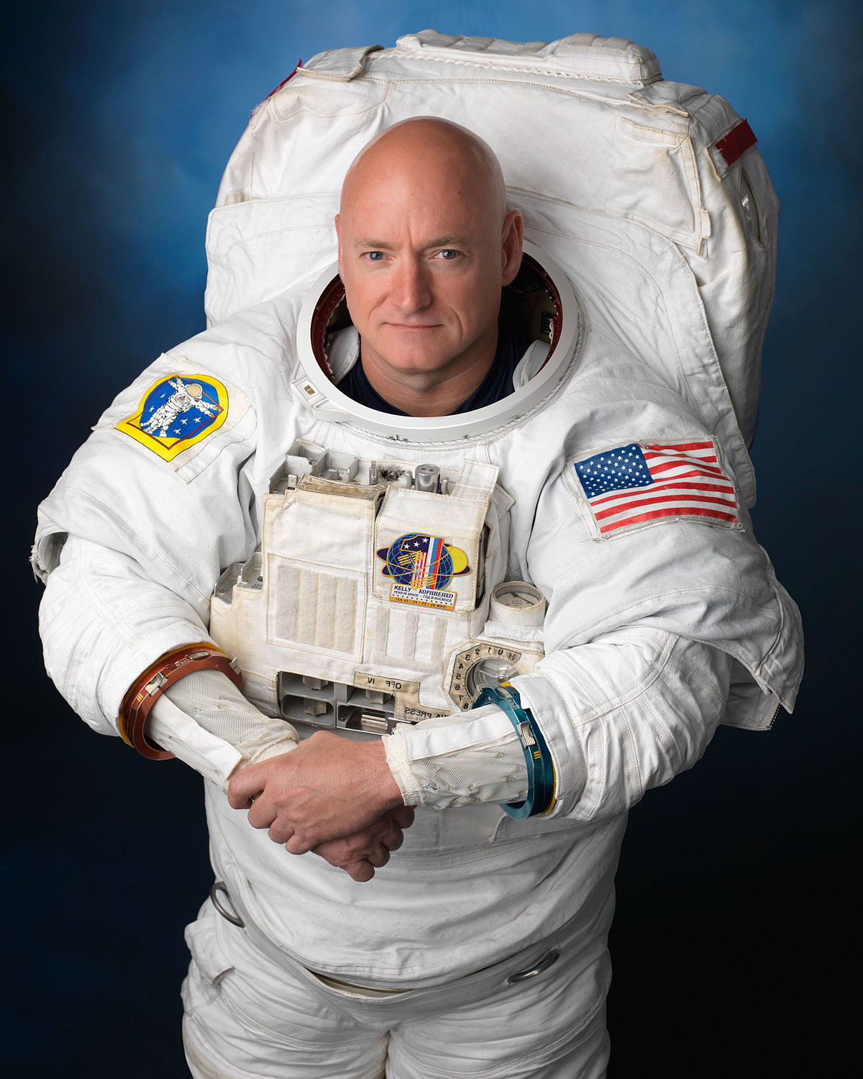
Motivation & Resources
Our Team has decided to work on this problem statement after reading about Scott Kelly who spent nearly a year on the International Space Station.
Scott Kelly's one-year mission was to better understand how the human body adapts to lengthy periods in space.
https://www.nasa.gov/sites/default/files/atoms/files/kellysj.pdf

Slide 3
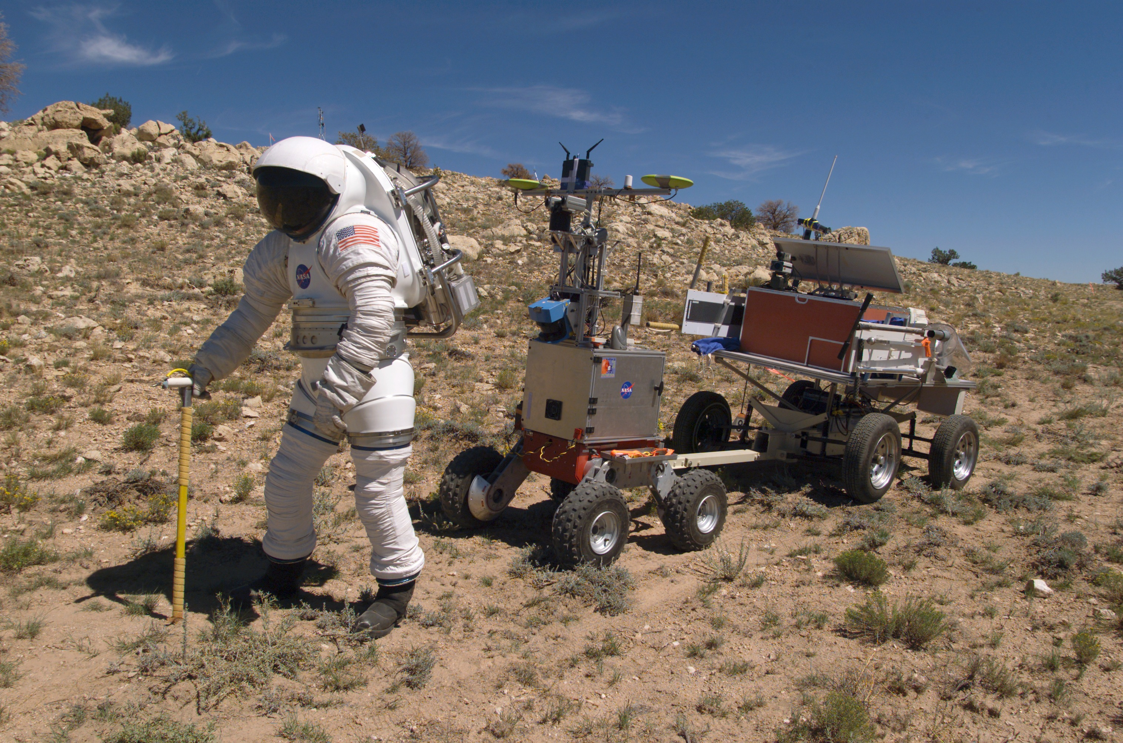
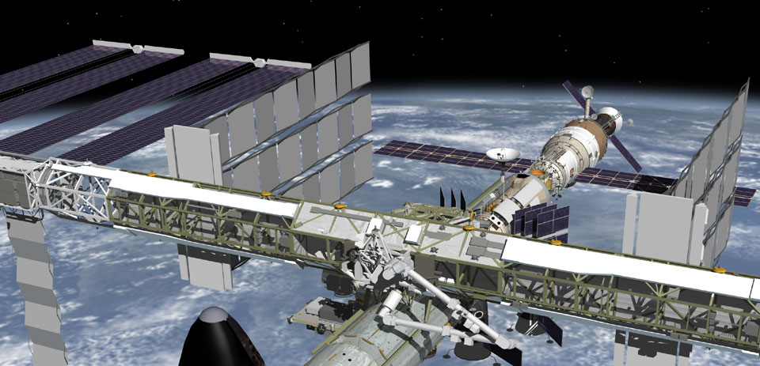
Space exploration imposes new challenges on human health

Slide 4
What is our Goal?
To present report & analysis for :
Effects on Psychological & Behavioral health
Effects on Physical Health

Slide 5
Challenges
Effects on Psychological & Behavioral health
Psychosocial stressors
Insomnia & Sleep
Circadian Rhythm
Duration of space travel

Slide 6
Physical factors that influence nature
Life evolved on earth while the force of gravity has been constant for 4.8 billion years.
Therefore, there is little or no genetic memory of life responding to gravitational force changes.
As we transition terrestrial life to low gravity environments and study the adaptive processes in cells, our understanding of the role of gravity in shaping evolution on Earth will increase.
The response of higher organisms to this ‘new’ environment may be less ordered than the response to say, thermal change.

Slide 7
What happens to humans in space?
Early response (<3 weeks)
Cephalad fluid shift
Neurovestibular disturbances
Sleep disturbances
Bone demineralization
Intermediate (3 weeks to 6 months)
Radiation exposure
Bone resorption
Muscle atrophy
Cardiovascular deconditioning
GI disturbances
Hematological changes
Long Duration (6 months to 3 years)
Radiation exposure
Muscle atrophy
Cardiovascular deconditioning
GI disturbances
Hematological changes
Declining immunity
Long Duration (6 months to 3 years)
Radiation exposure
Muscle atrophy
Cardiovascular deconditioning
GI disturbances
Hematological changes
Declining immunity
Renal stone risk

Slide 8
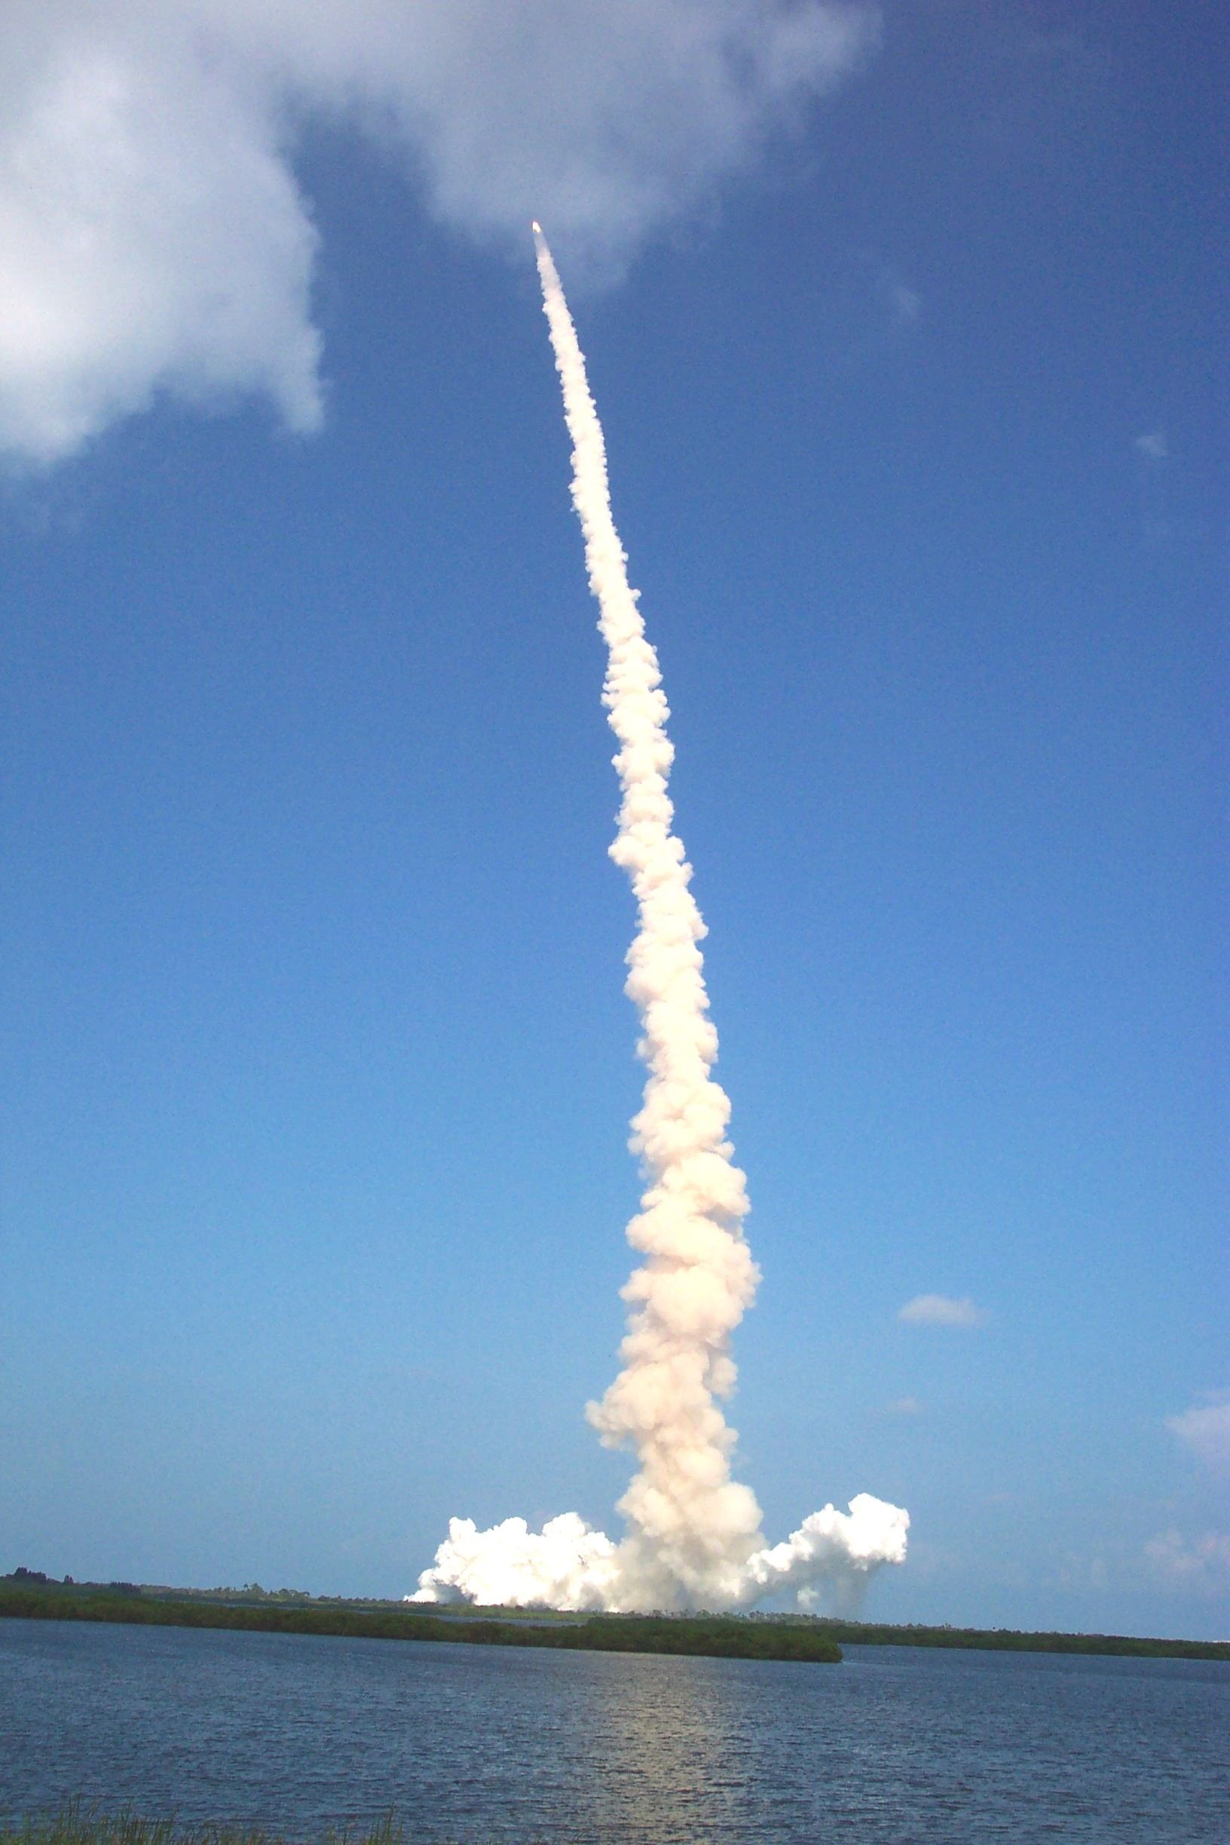
Risks to Humans in Microgravity
Exposure to ionizing radiation
Bone density decrease
Muscle Atrophy
Cardiovascular Deconditioning
Psychosocial impacts
Fluid Shifting
Vestibular Dysfunction
Hematological changes
Immune Dysfunction
Delayed wound healing
Gastrointestinal Distress
Orthostatic Intolerance
Renal stones

Slide 9
Impacts of Extended Weightlessness
Physical tolerance of stresses during aerobraking, landing, and launch phases, and strenuous surface activities
Bone loss
no documented end-point or adapted state
countermeasures in work on ground but not yet flight tested
Cardiovascular alterations
pharmacological treatments for autonomic insufficiency
Neurovestibular adaptations
vehicle modifications, including centrifuge
may require auto-land capability
Muscle atrophy
resistive exercise under evaluation

Slide 10
Radiation
Different from ionizing radiations on Earth
Two types
Galactic cosmic radiation (GCR) dominated by neutrons
Solar particle events (SPE)- sun storms dominated by protons
Earth is protected by the magnetosphere (van Allen Belt)

Slide 11
Radiation
Issue: Radiation Environment
Attenuation of GCR and SPE by atmosphere and bulk of planet
Possible risk from neutron backscatter from surface
TBD shielding for vehicle and habitat
Shielding high energy particles is difficult
Radiation effects (possible synergy with hypogravity and other environmental factors)
Early or Acute Effects from Radiation Exposure (esp. damage to Central Nervous System)
Carcinogenesis Caused by Radiation
Immune system compromises

Slide 12
Bone Loss in Weightlessness
5
Space flight
2 years post-menopause, n=13
n=22
(for comparison only)
0
-5
-10
Change from pre-flight (%)
-15
-20
?
-25
(months)
6
12
18
24
30
36

Slide 13

Causes of bone loss
No load because of low gravity
Poor muscle performance
Metabolic and hormonal changes
Fluid dynamic changes in the bone marrow sinusoids
Decreased hydrodynamic shear
Loss of hydrostatic pressure gradient
1 G
μ G

Slide 14
Countermeasures for bone loss
Resistive Exercise
Loading
Nutrition
Bisphosphonates

Slide 15
Muscle
Disuse Atrophy
Most locomotion achieved with the upper body
No load
No position based use and deployment of muscle activity akin to 1G environment
Unusual uses of selected muscle groups
Countermeasures
Exercise, exercise, exercise
Before, during, and after the mission

Slide 16
Risk Elements & Categories
Bone Loss
fractures, renal stones, osteoporosis, drug reactions
Cardiovascular Alterations
dysrhythmias, orthostatic intolerance, exercise capacity
Food and Nutrition
malnutrition, food spoilage
Immunology & Hematology
infection, carcinogenesis, wound healing, allergens, hemodynamics
Muscle Alteration
mass, strength, endurance, and atrophy
Neurovestibular Adaptations
monitoring and perception errors, postural instability, gaze deficits, fatigue, loss of motivation and concentration
H
uman
Human Health/
Physiology
H
ealth &
P
erformance

Slide 17
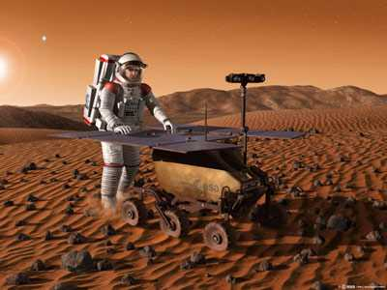
Contributors​
K Sai Varun​
Keerthanchand​
Sai Tarrun​
Sushantha Reddy​
Additional Resources

